Slide 1
Chapter 11
Communication and Collaboration
Sai Praneetha Jaladanki
Kishan Kalburgi Srinivas
Rahul Reddy Lankala
Naveen Kumar Puvvada

Slide 2
Topics
Introduction
Models of Collaboration
Specific Goals and Context
Design Consideration

Slide 3
Introduction - Communication
Communication is act of conveying intended meanings and messages from one group to other through different ways.
Non -Verbal Communication.
Verbal Communication.
Non –Verbal Communication:
Describes the process of conveying a type of information in the form of non-linguistic representations.
Examples : gestures, body language, Haptic Communication, Written texts(letters), Social Media.
Verbal Communication:
It is spoken or written way of conveying a message. Human language can be defines as a system of symbols and grammars.
Example: Social Media.

Slide 4
Introduction (continued)
Constant and immediate communication and interaction with family, friends, collaborators, colleagues, coworkers, and even pets is now commonplace in the increasingly networked world.
Social networks, newsfeeds, alerts and have become part of our daily lives.
Designers need to consider the downside and negative exigencies of such systems.
Communication and collaboration tools shape the ability to work and accomplish shared goals with one another.
Design for these systems can be more complex than single – user interfaces because of its far – reaching, networked and social aspects.

Slide 5



Gesture Communication
A gesture is a form of non-verbal communication or non-vocal communication in which visible bodily actions communicate particular messages, either in place of, or in conjunction with, speech.
Gestures include movement of the hands, face, or other parts of the body.

Slide 6


Haptic Communication
Haptic communication is a branch of nonverbal communication that refers to the ways in which people and animals communicate and interact via the sense of touch.
Touch can be categorized in many terms such as positive, playful, control, ritualistic, task-related or unintentional.
PLAYFUL POSITIVE & RITUALISTIC

Slide 7
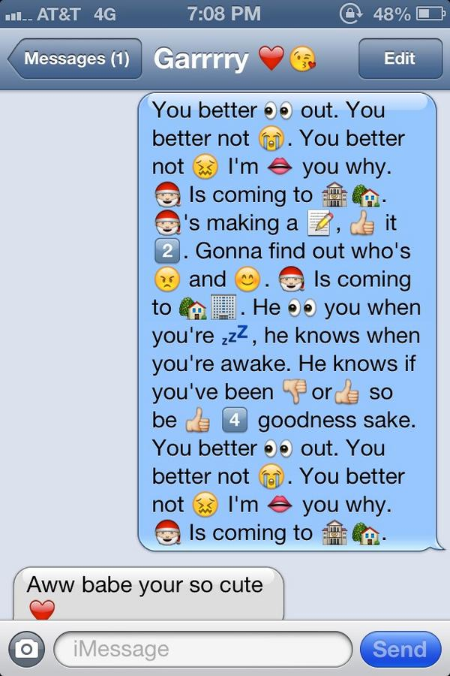
Textual Communication
Non-verbal communications are multifunctional. Textual communication can be both verbal and non-verbal communication.
Based on the usage of the language and colors one can decide the nature of communication.
Usage of emoji’s and capitalization is a clue foe usage of non-verbal medium.

Slide 8
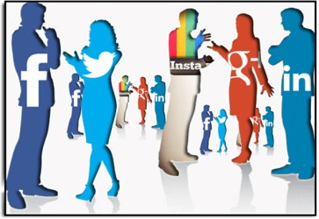
Social Media
Social media refers to the means of interactions among people in which they create, share, and/or exchange information and ideas in virtual communities and networks.
These social media communication can be public/private depending on the users ideology.
Some examples of social networking are:
Twitter
Facebook
Mails
Snapchat
News

Slide 9
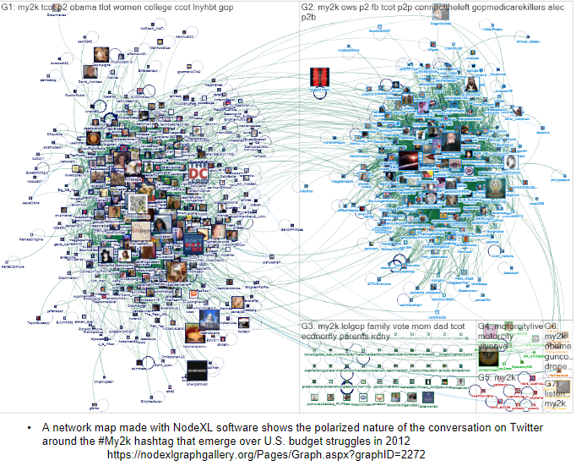
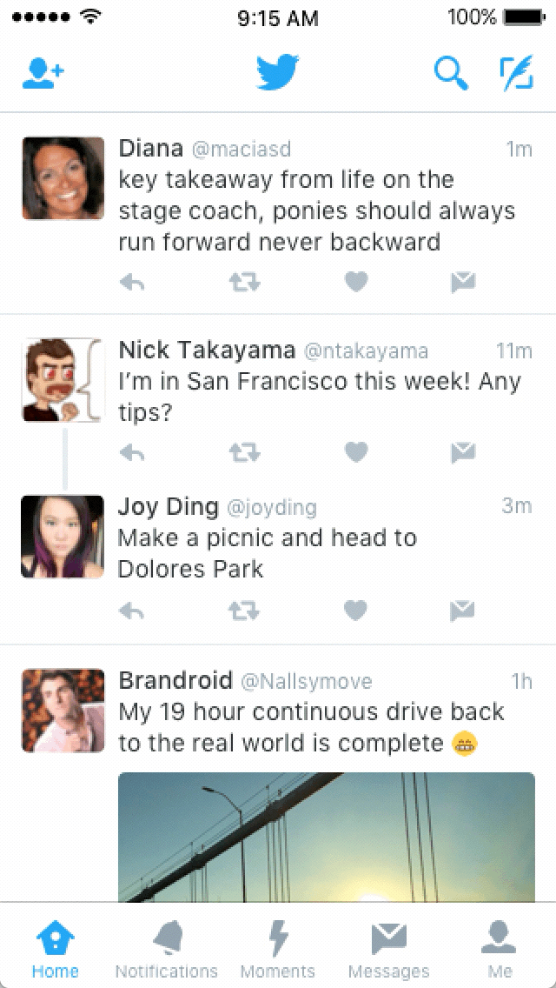
Social Media (continued)
Twitter is an online news and social networking service where users post and interact with messages, known as "tweets."
These messages were originally restricted to 140 characters, but on November 7, 2017, the limit was doubled to 280 characters for all languages except Japanese, Korean, and Chinese.

Slide 10
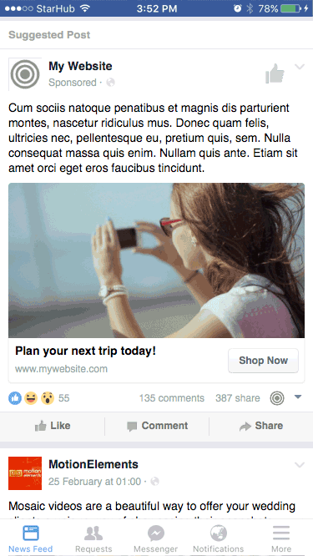
Social Media (continued)
Facebook
Facebook is another medium for conveying messages and information in a large scale.
Usage of Facebook is growing day by day it has become a zone for games, news, personal dairies.
Facebook is another best platform for advertising.

Slide 11
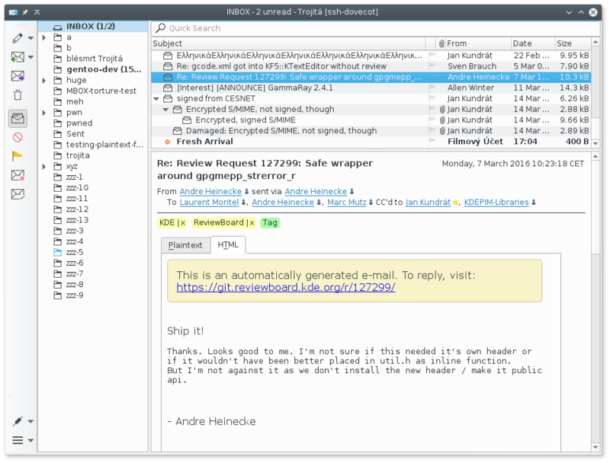
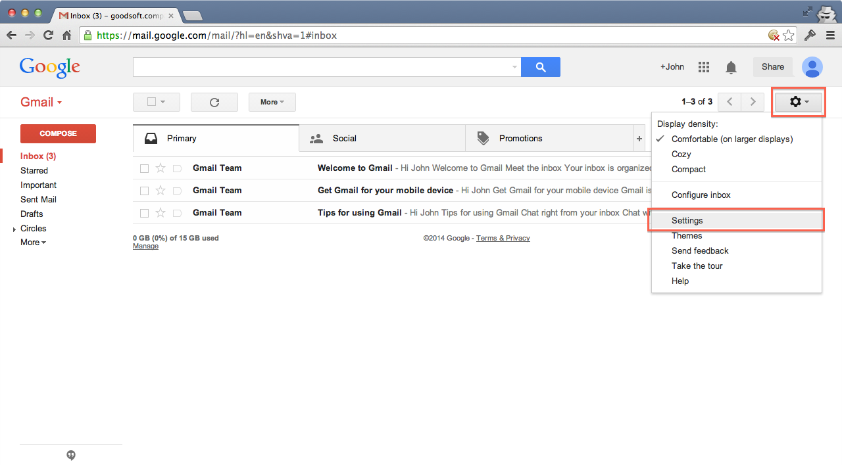
Social Media (continued)
Mails
Mails are one of the famous way of sending important texts and information from one peer to other.
Emails like traditional business letters must be clear and concise. The body of the email should be direct and informative.

Slide 12
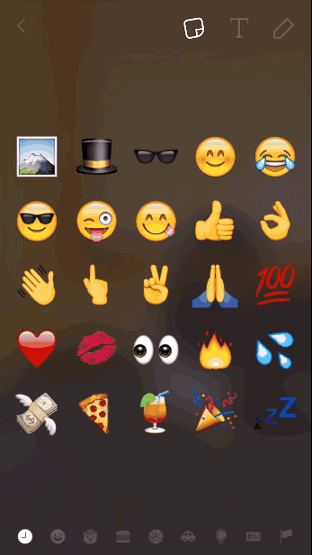
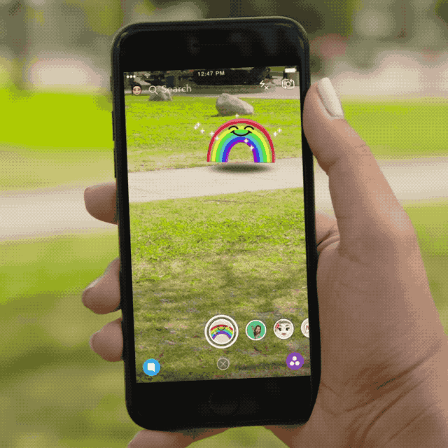
Social Media (continued)
Snapchat
Snapchat is an image messaging
and multimedia mobile application.
The app has evolved from originally focusing on person-to-person photo sharing to presently featuring "Stories" of 24-hour chronological content, along with "Discover" to let brands show ad-supported short-form entertainment.
Snapchat is the first social media for usage of virtual reality stickers and augmented reality objects.

Slide 13
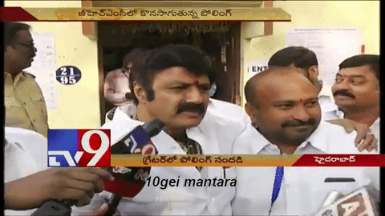
Social Media (continued)
News
The news media or news industry are forms of mass media that focus on delivering news to the general public or a target public.
Media is a large network where we can get to know what happens in the world with just fingertips away.

Slide 14
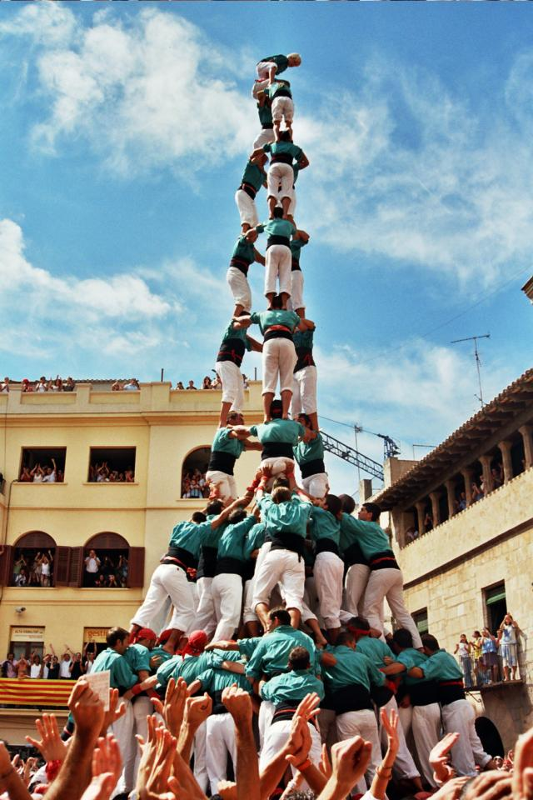
Collaboration
Collaboration occurs when two or more
people or organizations work together
realize or achieve a goal.
Most collaboration requires leadership.

Slide 15


Means of Collaboration
The atomic unit of collaboration for electronic-mail users is the message; the FROM party sends a message to the TO party.
Newsgroups, list servers, discussion boards, conferences, blogs, and wikis

Slide 16

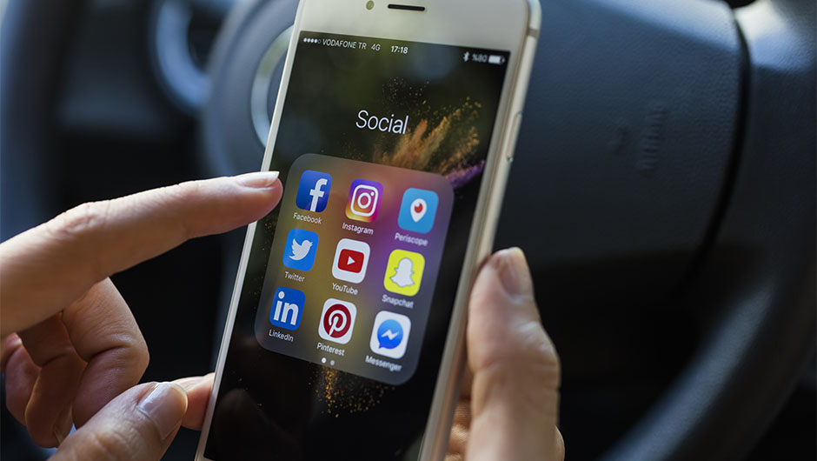
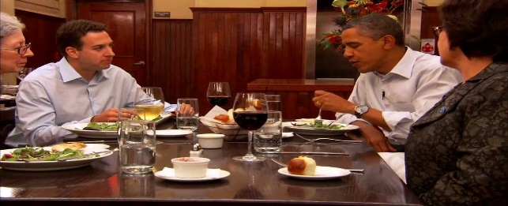
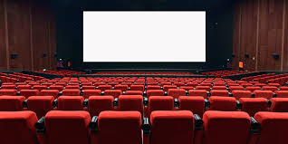
Models of Collaboration
Consider a typical day of your busy life:
wake up
see social media sites
go to work
chat with a friend at work
post a question to a video or a blog
on the way out of the office, text a friend to coordinate dinner plans.
After dinner receive a crowd-based recommendation for a movie to watch.

Slide 17

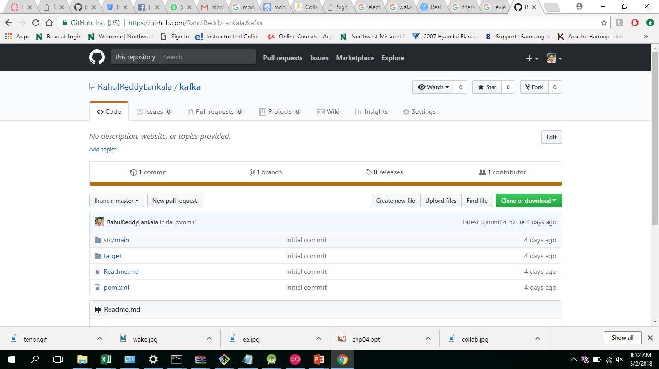
Synchronicity
https://github.com/RahulReddyLankala/kafka

Slide 18
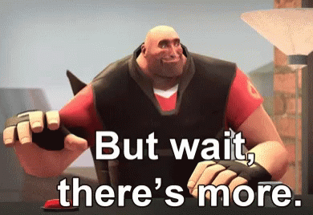
Elements of Successful Collaboration
The idea of collaboration seems easy enough – just work together. But there’s more to it than that.
https://tenor.com/search/but-wait-theres-more-gifs

Slide 19
Elements of Successful Collaboration (contd.)
Clear definitions and agreements on the roles of partners.
Open communication within teams to share the information necessary to carry out tasks.
Identification of obstacles and addressing problems cooperatively as they occur. Teamwork is essential at all times.
Group goals are placed above personal satisfaction and/or recognition.
Willingness to apologize for missteps and ability to forgive others for mistakes.

Slide 20
Feed Back
Although collaboration is often described as a “soft skill,” in today’s workplace it is just as vital as hard skills such as one's educational background and/or technical knowledge.
Even though productive collaboration skills may not be innate to some individuals, they can easily be learned and practiced to perfection.

Slide 21
Specific Goals and Contexts
Why do you think people collaborate
?
Notes:
People collaborate because doing so is satisfying or productive. It allows individuals to reap the emotional rewards of socializing and interacting with others to accomplish there goals

Slide 22
Specific Goals and Contexts
Communication and Conversation
Online Markets
Meeting Coordination
Creative Production
Crowdsourcing and Crowdwork
Entertainment and Gaming
Education
Notes:
Crowdsourcing and Crowdwork, e.g. restaurant reviews, e.g. sites to hire contractors
Entertainment and Gaming, e.g. Massive Multiplayer Online Role-Playing Games (MMORPG)
Education, e.g. Massive Open Online Courses (MOOC)

Slide 23
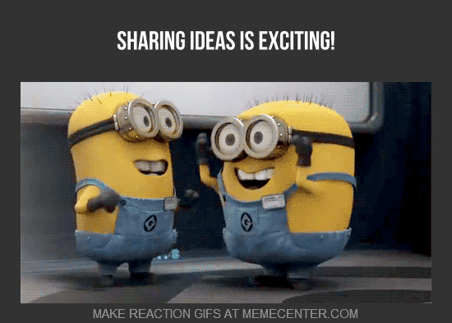
Communication and Conversation
Most of the people share there ideas, information, and experience with family, or friends via conversation
www.mskellyatthelibrary.blogspot.com

Slide 24
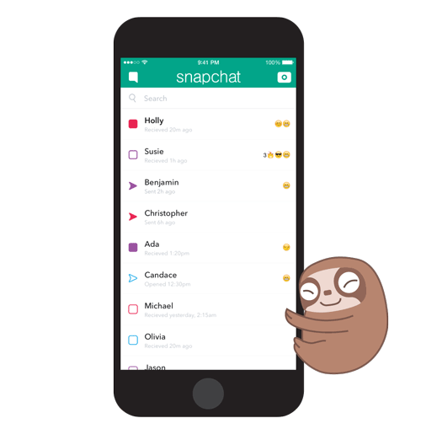
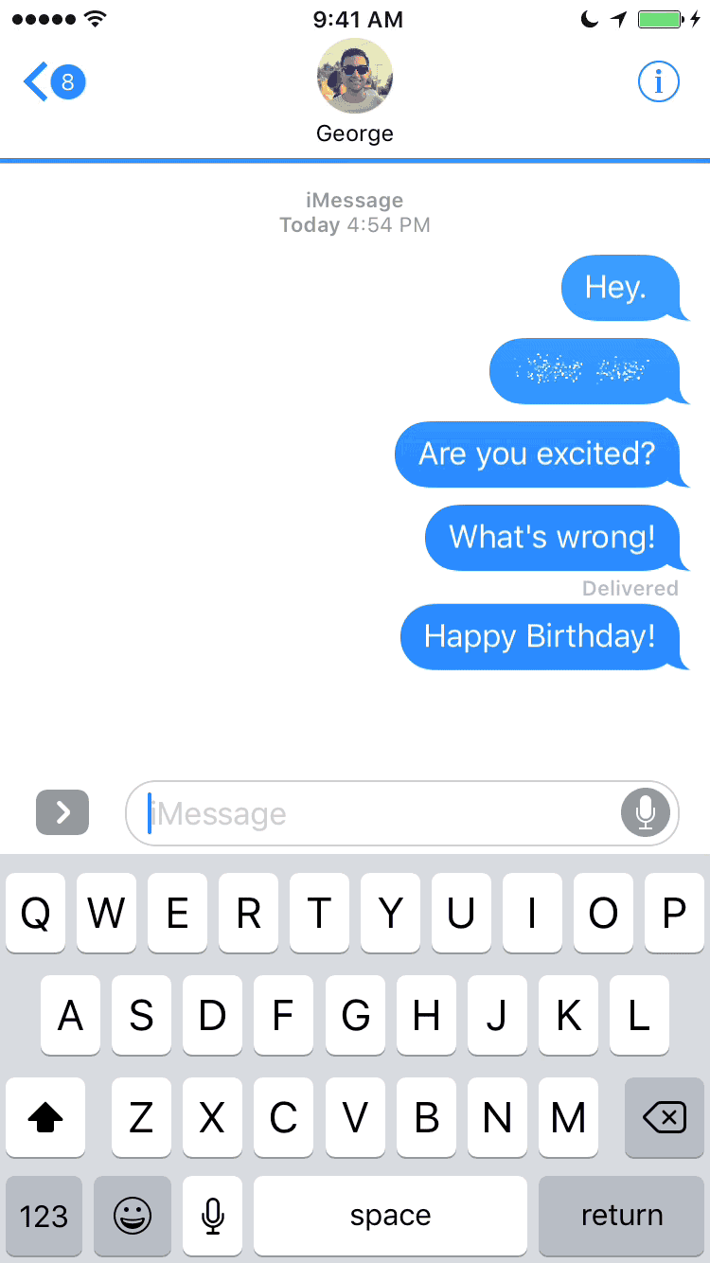
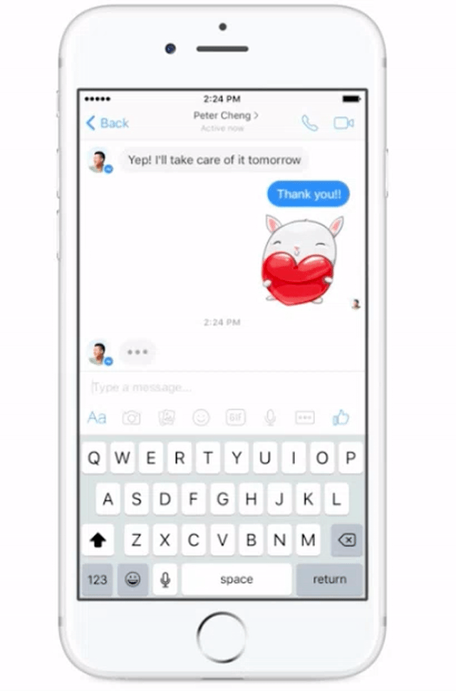
Communication and Conversation
We can do this via voice, writing down those ideas, or by Animated emoji (started by Apple Inc.)
Tools for available conversation
Snapchat
iMessage from Apple
Facebook Messenger

Slide 25




Online Markets
Buying, selling, and trading – they’ve been driving commerce for few thousands of years.
From past 20 years the nature of these activates has been changed dramatically as people adopt internet for shopping, trading, and selling.
www.amazon.com
www.flipkart.com
www.airbnb.com
www.ebay.com

Slide 26

Online Markets
Amazon customer reviews for Horse head mask
www.amazon.com

Slide 27
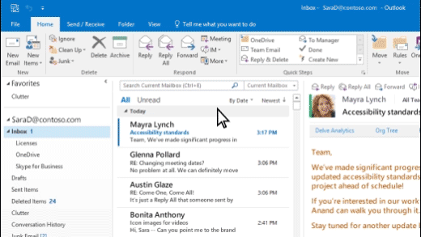
Meeting Coordination
Sometimes user need a communication tool in order to coordinate a meeting time and location
Such tools allow user to create a group and communicate with all the group members at a time
Microsoft Outlook

Slide 28
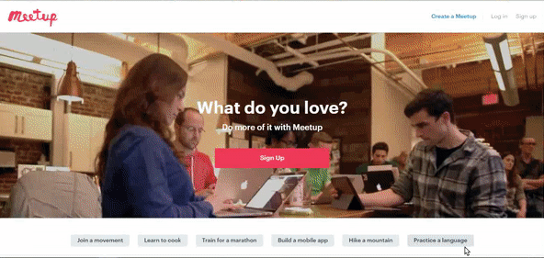
Meeting Coordination
www.meetup.com
Notes:
Features:
Send emails to group members
Record RSVP’s (Respond please)
Manage attendance
Upload and share photos, videos after event
Comment on events .. Etc,.

Slide 29




Meeting Coordination
Another very popular context for meeting is online dating sites.
Needs for such tools very different when compared platforms like MeetUp.com
Main difference is scale of meeting, in this case……?
Potential romantic partners need ways to break the ice, it can be awkward sometimes
This can be over come by talking to each other via dating platform
www.tinder.com
www.okcupid.com

Slide 30




Creative Production
Whether it’s developing new software, writing an online encyclopedia, or animating a movie, big creative projects demand that users work together
Work need to broken down in to pieces and re-assembled by underlying all the requirements
Various platforms and tools exist to help facilitate these activates such as,
www.github.com
www.dropbox.com
www.slack.com
Notes:
Social coding platforms like Github
File-sharing tools like dropbox
Project management tools like slack
Video production (movie making)

Slide 31





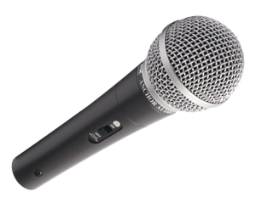
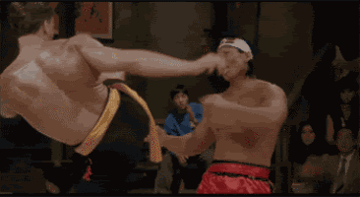
Creative Production
Director
Music Director
Dance Choreographers
Fight master/Action choreographer

Slide 32



Crowdsourcing and Crowdwork
A growing number of online services exist to help people find paid work as contractors online
The range of crowdwork platforms available, such as

Slide 33
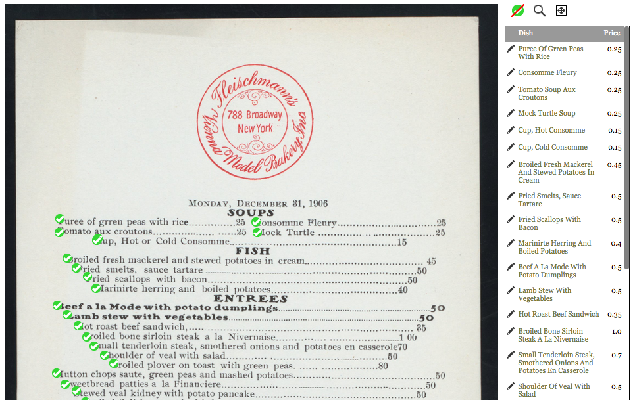
Crowdsourcing and Crowdwork
Historical menu from Fleischmann’s Bakery digitized by the New York Public Library in collaboration with thousands of crowdsource volunteers who helped type in individual menu items
www.menus.nypl.org/menu_pages/5247

Slide 34
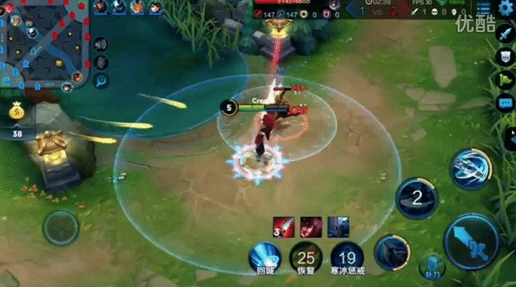

Entertainment and Gaming
Massive multiplayer online role-playing games (MMORPGs)
Such as,
World of Warcraft
Star Wars: The Old Republic
Whether fantasy, sci-fi, or otherwise themed, people enjoy playing such immersive games as they allow not only for the traditional fun of games, with goals, scoring and advancement , competition, and of goals.
World of Warcraft
Star Wars

Slide 35
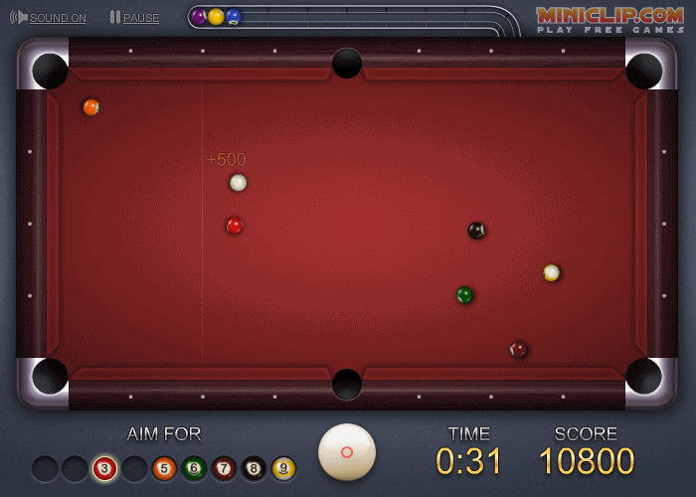
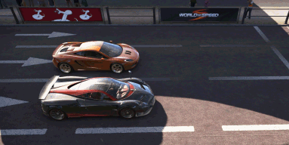
Entertainment and Gaming
Other online social game include those that are integrated into social network sites like Facebook or Google where player can find and compete against others in classic games like 8pool etc,
8 pool
www.store.steampowered.com

Slide 36



Education
Recent year have witnessed an explosion of interest in interactive course materials available online from platform like,
These courses have come to be known as massive open online courses (MOOCs) because they often offer open enrollment and attract anywhere from 100 to 10,000 students

Slide 37
Design Considerations

Slide 38
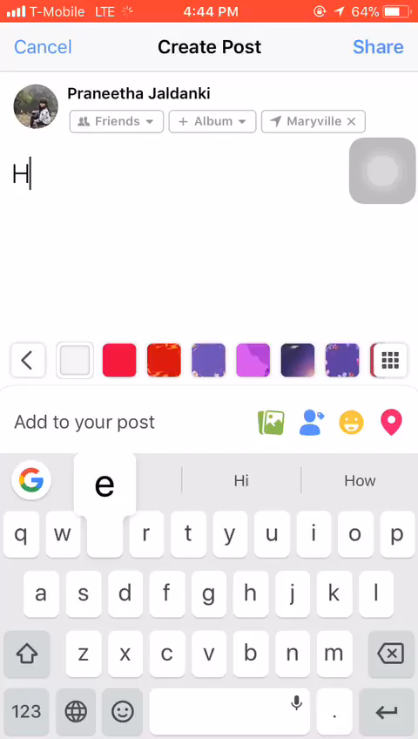

Cognitive Factors
Common Ground
Establishing a common ground while communication is very important for effective collaboration
One common type of referencing is by pointing out a finger to an object
Another way of referencing is to generalize the subject
On social media, one can reference in different ways in different platforms
Common Ground
Establishing a common ground while communication is very important for effective collaboration
One common type of referencing is by pointing out a finger to an object
Another way of referencing is to generalize the subject
On social media, one can reference in different ways in different platforms
http://www.safebee.com/health/what-do-if-youre-stuck-elevator

Slide 39
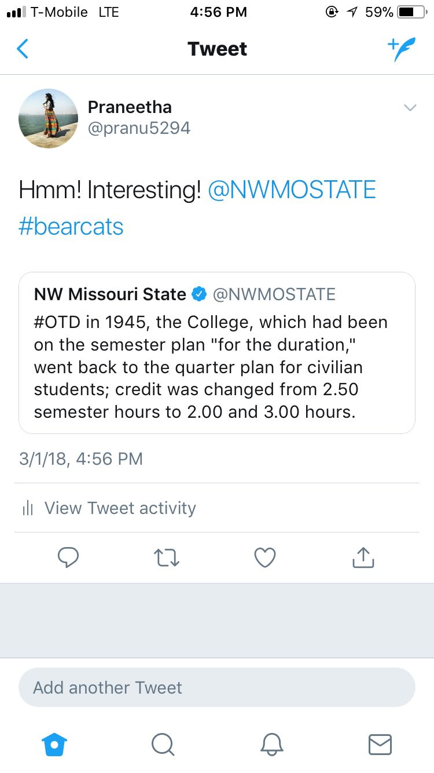
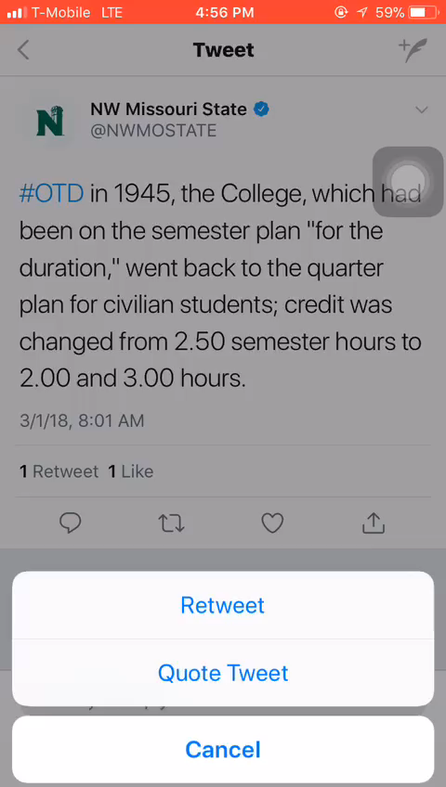
Cognitive Factors
Common Ground
On social media, one can reference in different ways in different platforms
In Twitter, you can retweet or quote a tweet
On Facebook or Instagram, you can tag your friend or any other user by using ‘@’ before their name.
To know more about a common topic you can simply follow the topic name preceding with a ‘#’

Slide 40

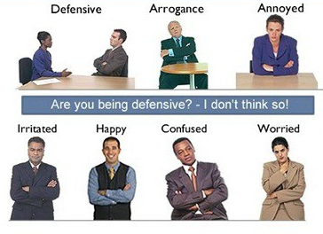

Cognitive Factors
Social Cues
Emoticons or Emojis as they are properly known are the most popular non verbal form of communication
Other non verbal communications are hand gestures, gaze and body postures
In chat based systems, the most popular non verbal communication are the emojis
http://tgifridays.tumblr.com/post/104414185390/fridays-holiday-hacks-hilarious-charades-clues
https://vivegroups.com/body-language-non-verbal-communications/

Slide 41
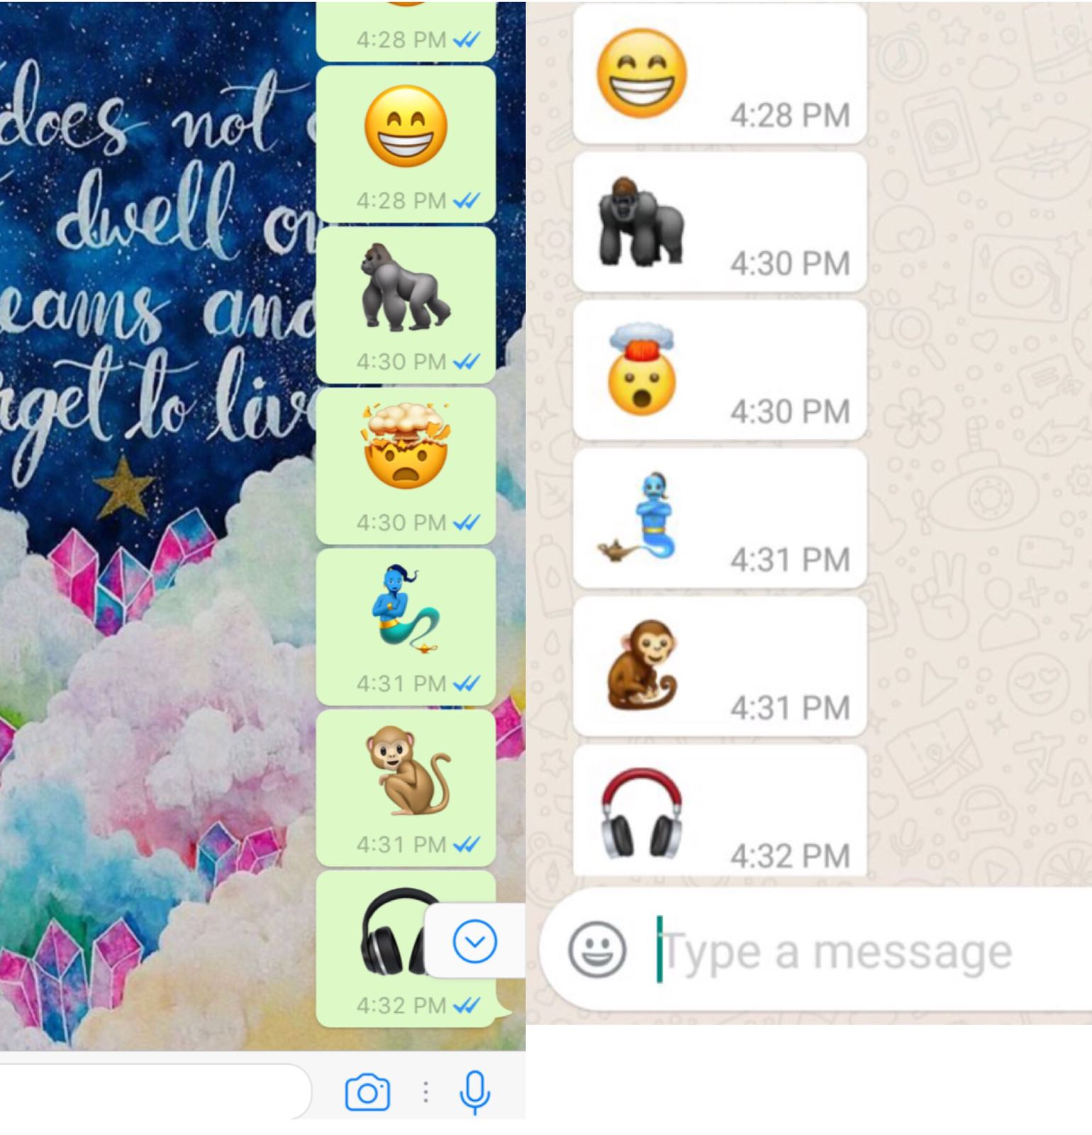
Cognitive Factors
Social Cues
Different versions of different devices display the same emoticon in different ways
Emoticons or Emojis as they are properly known are the most popular non verbal form of communication
No matter how they are different in design, they can effectively communicate the idea

Slide 42
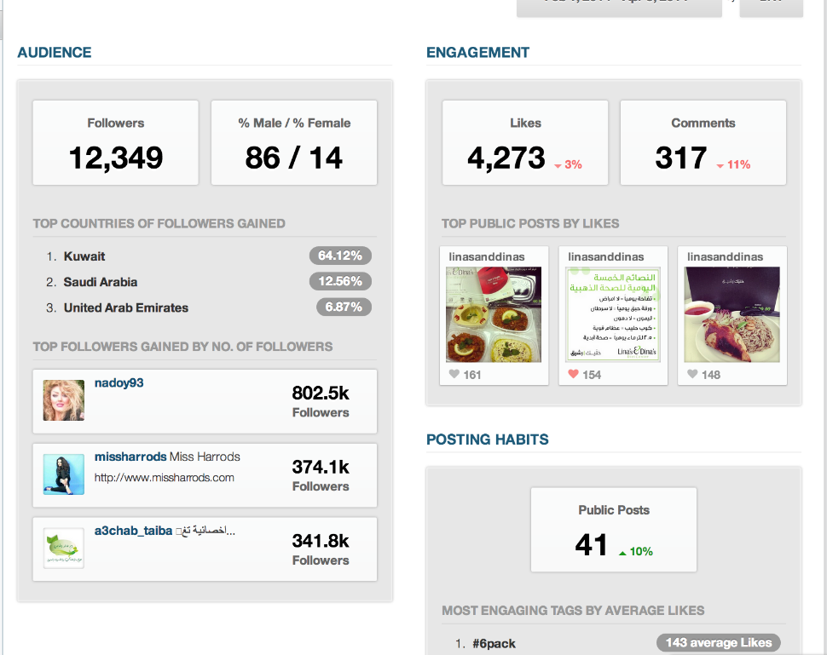
Cognitive Factors
Activity Awareness
Keeping track of activities on any platform provides accountability
We can also keep track the contributors performing the task
To revert back changes if any, it is easy to identify the steps and do the necessary action
Bar graphs and other data visualization tools can be used to monitor the activity
http://blog.socialobby.com/2014/04/now-brands-can-have-deeper-look-sense.html

Slide 43
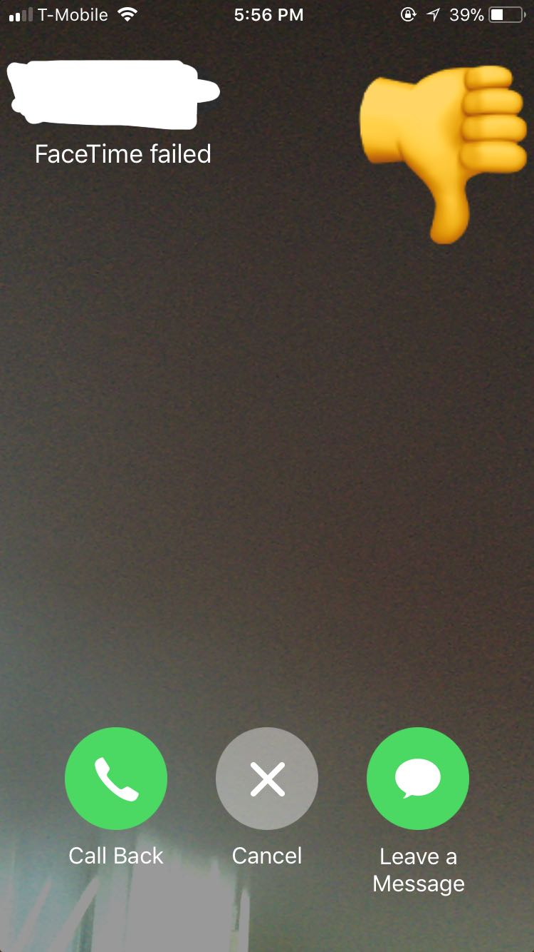
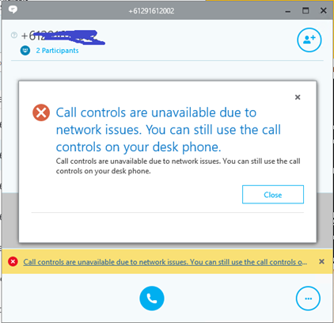
Cognitive Factors
Interruptions
Any unseen instance that causes communication to pause or stop is called interruption
Network issues, failed connectivity, poor internet services are few of the major interruptions a user can experience
During an on-going call, a new message, alert or another call may cause an interruption and provide hindrance in communication
https://blogs.technet.microsoft.com/stevemoore/2017/06/14/call-controls-are-unavailable-due-to-network-issues-call-via-work/

Slide 44
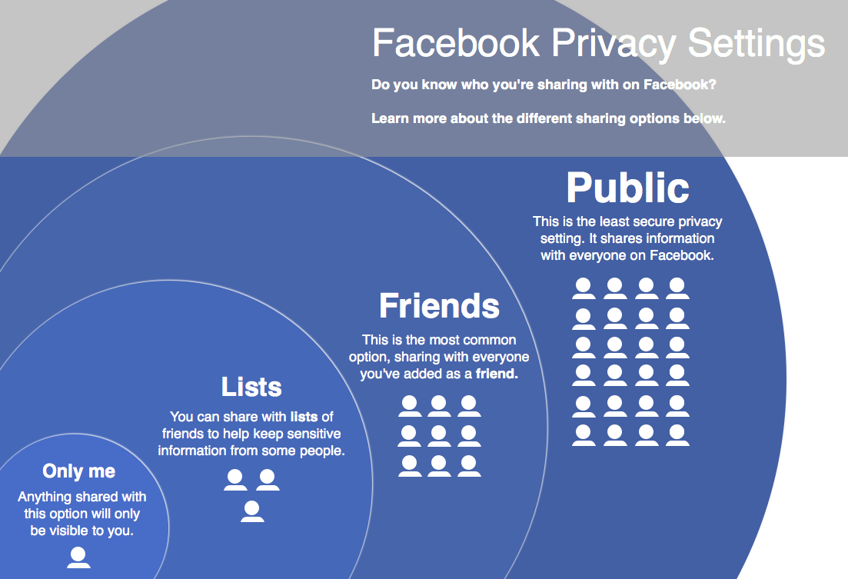
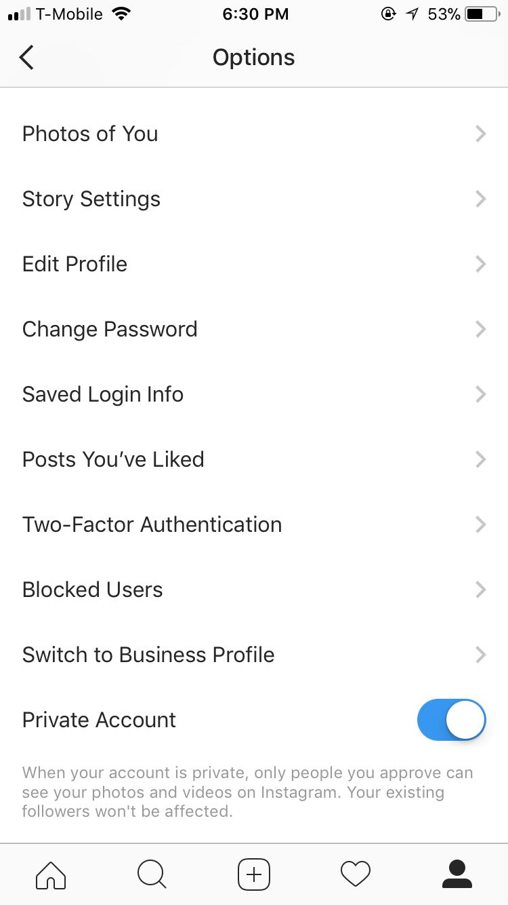
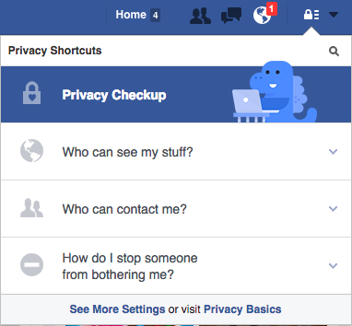
Individual Factors
Privacy
Important to know who has performed what activity
Need privacy to limit audience
Different users may need different amounts of privacy

Slide 45
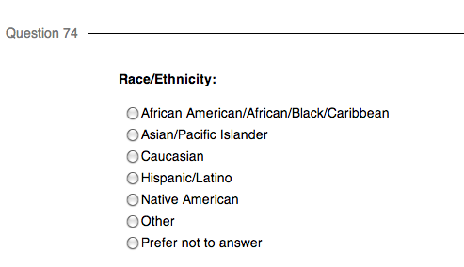
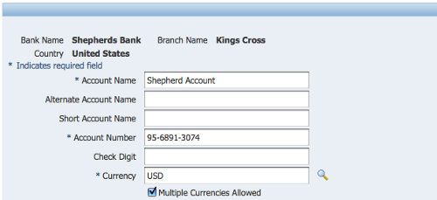
Individual Factors
Identity
Online communities ask many questions to know how people portray themselves
This is when there is no physical presence of the person to validate
The decision to reveal their identity relies completely with the user
However, in case of financial transactions, it is mandatory.
https://multiracialnetwork.wordpress.com/tag/survey-question/
https://www.packtpub.com/books/content/oracle-e-business-suite-creating-bank-accounts-and-cash-forecasts
Notes:
Anonymous, Newspapers, Forms,
Banks, emails, donations
Pen names
Quora
https://www.cartoonstock.com/directory/a/anonymous_donations.asp

Slide 46
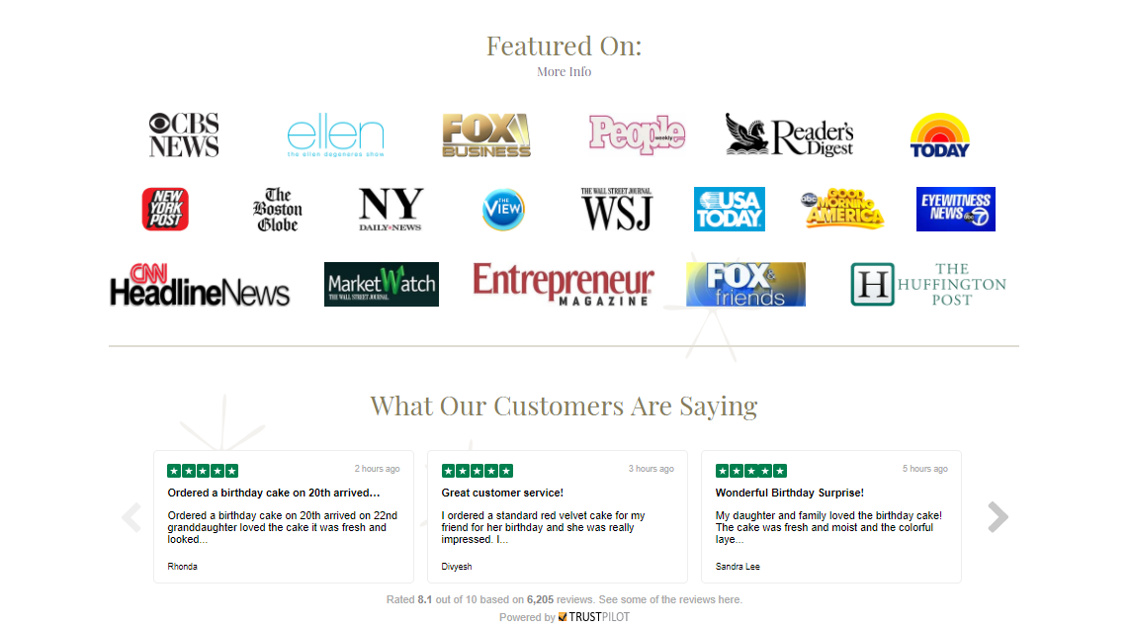

Individual Factors
Trust and Reputation
Online users build trust upon the performance and the reviews of other users
Positive reviews and high performance statistics tend to build trust amongst the users
Customer complaints, inefficient system of work structure leads to bad reputation
www.bakemeawish.com/
https://wwhttps://www.highya.com/wish-com-reviews
Notes:
https://www.bakemeawish.com/
https://www.highya.com/wish-com-reviews

Slide 47



Individual Factors
Motivation
The need to communicate and engage is very important in a interactive system
There are active media consumers and each of them have their specific needs
The user motivation is better understood through survey polls, interest groups and the rising popularity of that particular media
https://en.instagram-brand.com/guidelines/general
http://www.stickpng.com/img/icons-logos-emojis/tech-companies/netflix-logo
https://twitter.com/linkedin
Notes:
Linkedin – resume
Tinder – meet new people
Instagram – to upload pictures
Netflix
Dropbox- storage
Pure amusement and entertainment

Slide 48

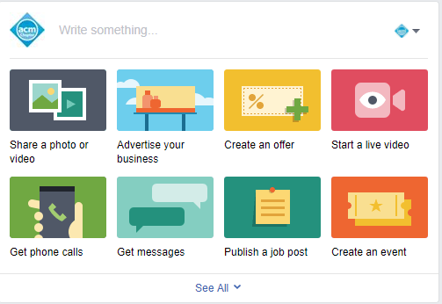
Individual Factors
Leadership
The ability to guide a group’s interest
Should maintain awareness of the group’s nature of work
Leader is also the member of the group but articulates higher level of the group ideas
Often initiate projects, suggest ways to regulate the activities of the group and takes responsibility
https://www.iconfinder.com/Icons/266546/community_group_leader_office_icon#size=128

Slide 49
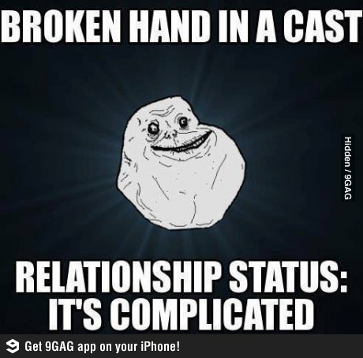
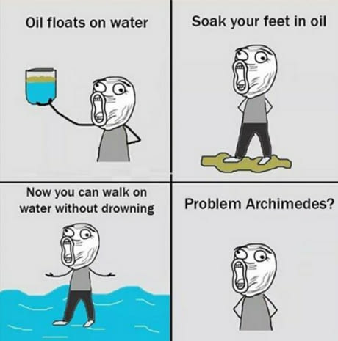
Collective Factors
Deviance
Any type of behavior different from the usual and standard ways
Different cultures, different societies and different diversity groups have different norms that they follow
People intentionally violating these norms are termed to be ‘trolls’
https://www.buzzfeed.com/kaylayandoli/yo-momma?utm_term=.hgAE1NLr1E#.se85NJODN5
https://9gag.com/tag/troll-physics

Slide 50
Collective Factors
Policies and Norms
Defines what content is acceptable and un-acceptable to the users
Any violation of such norms is punishable legally
Spell check, duplicate postings, look out for original content are few of the rules that are implied
Automatically, any content posted with deviations can be taken down keeping in mind the design implications of the communication technology
Moderation
A moderator resolves the issues faced in deviation
A moderator could be a person or an algorithm to filter posts by the text, fake reviews etc.
To solve an issue, a moderator can ban the user, provide transparency, and explain the community guidelines.

Slide 51

Summary
The most effective way of communication, irrespective of the medium, is the best when it is clear, short and easily understandable
Communication breaks barriers of language, culture, race and nationality when expressed in common social cues
Collaboration comes into the picture when there is a lot to convey and it can be done in very organized way
Implementing design in communication always leads to less interruptions, high clarity and the scope of improvement is always evident
Notes:
https://steemit.com/communication/@juvyjabian/learning-effective-communication-skills-and-understanding-its-importance-is-the-key-to-every-success

Slide 52

Questions?

Slide 53


